Slide 1
https://www.mongodb.com/what-is-mongodb
MongoDB stores data in flexible, JSON-like documents, meaning fields can vary from document to document and data structure can be changed over time
The document model maps to the data objects in your application code, making data easy to work with
Ad hoc queries, indexing, and real time aggregation provide powerful ways to access and analyze your data
MongoDB is a distributed database at its core, so high availability, horizontal scaling, and geographic distribution are built in and easy to use
MongoDB is free and open-source, published under the GNU Affero General Public License

Slide 2
document-oriented database
A document-oriented database is a db program designed for storing, retrieving, and managing document-oriented information, also known as semi-structured data.
Document-oriented databases are one of the main categories of NoSQL databases and the popularity of the term "document-oriented database" has grown with the use of the term NoSQL itself.
Document-oriented databases are a subclass of the key-value store, another NoSQL database concept. The difference lies in the way the data is processed; in a key-value store the data is considered to be inherently opaque to the database, whereas a document-oriented system relies on internal structure in the document in order to extract metadata that the database engine uses for further optimization.
Document databases contrast strongly with the traditional relational database .
Relational databases generally store data in separate tables that are defined by the programmer, and a single object may be spread across several tables.
Document databases store all information for a given object in a single instance in the database, and every stored object can be different from every other.
This makes mapping objects into the database a simple task, normally eliminating anything similar to an object-relational mapping.

Slide 3
How to use free MongoDB in the cloud
There were several companies offering MongoDB “as a service” in the cloud. Most of them let you have a small (500 MB) database for free, and then they charge money if you want a larger one.
I previously used www.mlab.com
I started with that one and it gave me no problems. But they got bought, so now using new one. https://www.mongodb.com/cloud/atlas

Slide 4
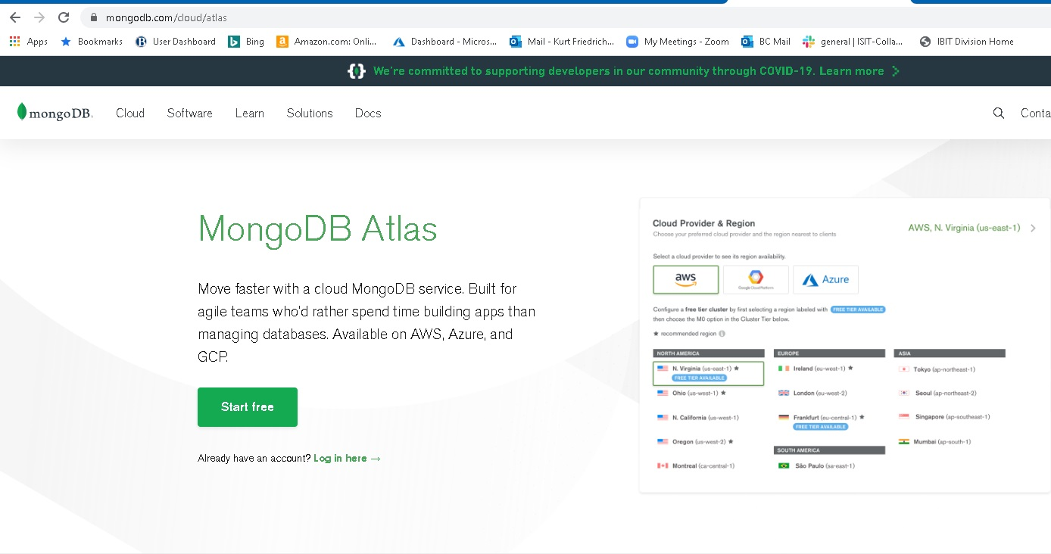
Go to https://www.mongodb.com/cloud/atlas and create a new account this is the “management account”

Slide 5
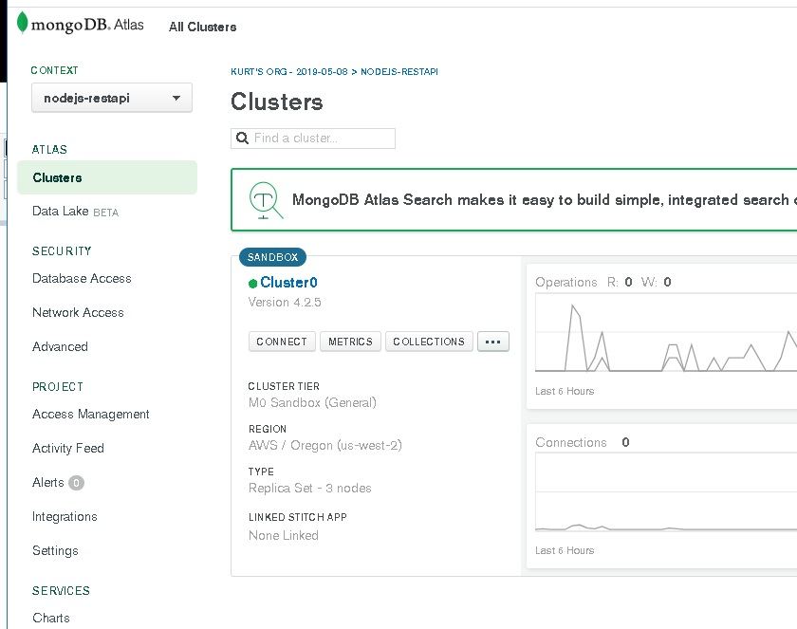
You have to define a cluster (in theory, a set of replicated systems)
Then click on Collections
To create a DB

Slide 6
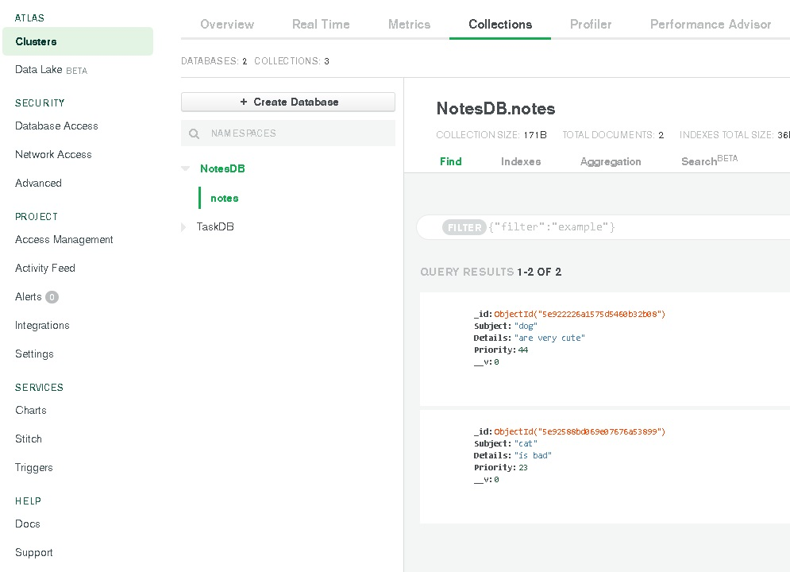
I have 2 DBs, and my NotesDB has one collection (~table)

Slide 7
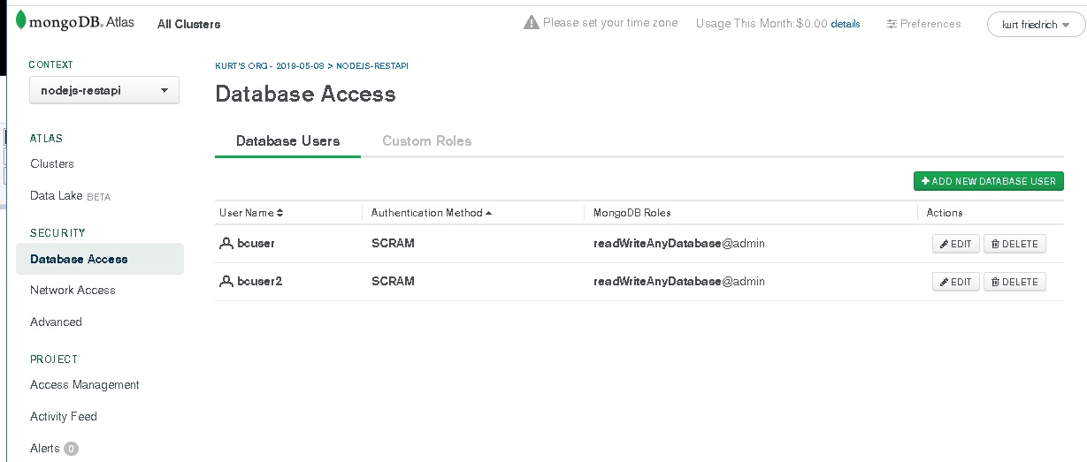
Click Database access to create “user accounts”, you just need 1 Make your password just letters and numbers, or you will have to learn “URL encoding”

Slide 8
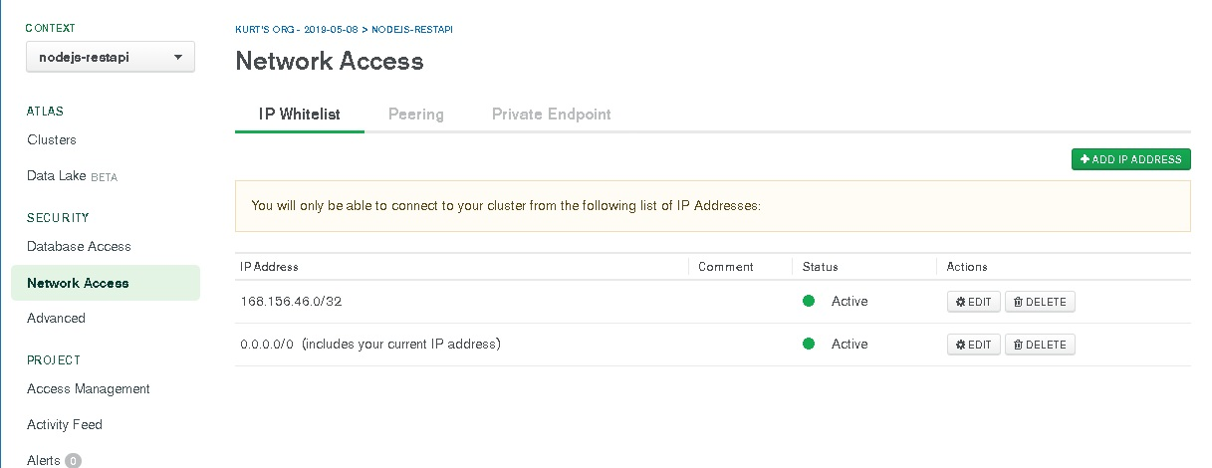
You have to list the URLs you will access your DB from, but there is an option to accept any.
Adding the CIDR 0.0.0.0/0 allows access from anywhere

Slide 9
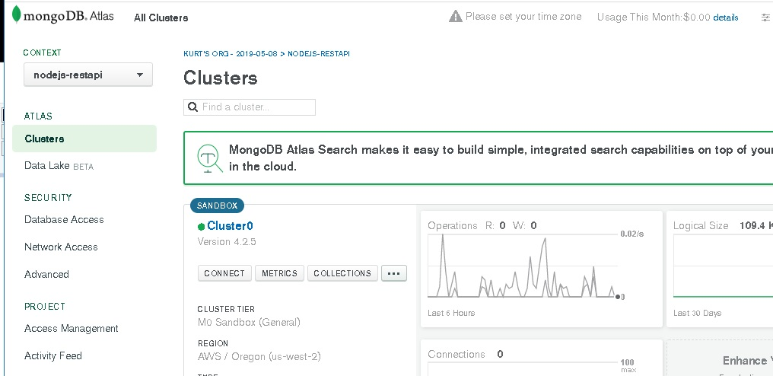
Click connect to find out your “connection string”

Slide 10
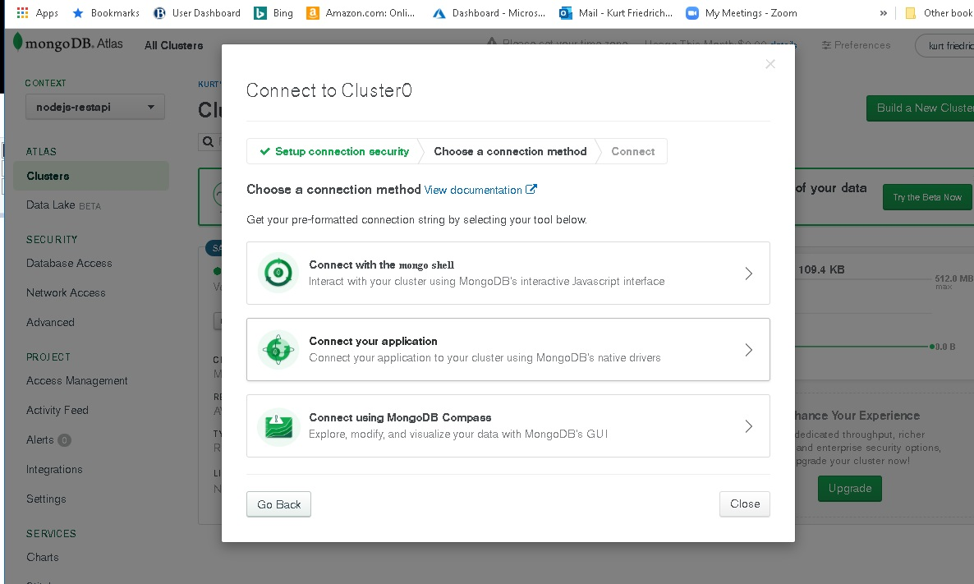
Choose the 2nd option

Slide 11
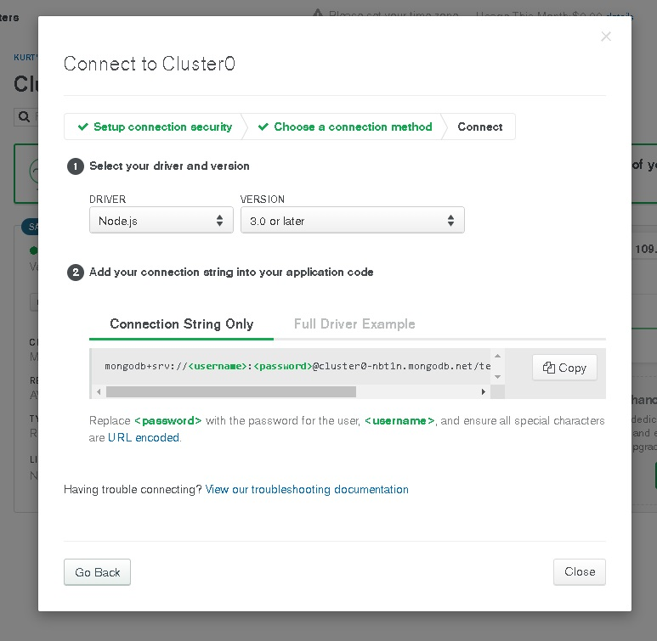
You will use this connection string in our JavaScript code.

Slide 12
We are done.

